Slide 1
ACT2111 Tutorial-Ch 6
ACT2111 Teaching Team

Slide 2

Content
Key Points of Chapter 6
Periodic System
COGS under 4 Methods
LCNRV
Inventory Analysis
Difficulties in Tutorial Questions

Slide 3

Key Points of Chapter 6
Periodic System
COGS Calculation – 4 Methods
3 Steps for calculation
Special Identify, FIFO, LIFO, Average-Cost
LCNRV
Inventory Analysis

Slide 4
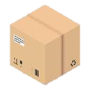
Periodic System – vs. Perpetual System
Here is a rough example shows the difference between Perpetual System (learnt at Chapter 5) and Periodic System (learnt at Chapter 6)
Date
Inventory Sold Out
Perpetual Journal Entries
(Focus on COGS)
Periodic Journal Entries
(Focus on COGS)
Jan. 1st
$ 100
Dr. COGS $100
Cr. Inventory 100
Jan. 3rd
$ 110
Dr. COGS 110
Cr. Inventory 110
No entry
Jan. 15th
$ 90
Dr. COGS 90
Cr. Inventory 90
Jan. 27th
$ 100
Dr. COGS 100
Cr. Inventory 100
Jan. 31st
(End of the period)
No entry
Dr. COGS $400
Cr. Inventory 400

Slide 5
Periodic System – Concepts Clarification
Beg. Inventory
Goods Purchased
Cost of Goods Sold
End. Inventory
Goods Available for Sale
Under periodic system, at the period end we have the amount of
End. Inventory : The inventory we finally on hand at the period end
Beg. Inventory : The inventory left from last period
Goods Purchased :The goods we purchased during the period
Goods Available for Sale: The goods available for sale during the whole period

Slide 6
COGS Calculation – 3 Steps & 4 Methods
FIFO
Special Identification
Average-Cost
LIFO
Review: ACT2111 Chapter 6 P14 - 17
Three steps to calculate COGS for a period
Calculate Cost of Goods Available for Sale
Total goods available during the whole period
Calculate Ending Inventory
Determine which method you use: FIFO, LIFO, Average-Cost or SI ?
1. Determine the unit in ending inventory
2. Determine the cost for every unit
COGS = Cost of Goods Available for Sale – Ending Inventory

Slide 7
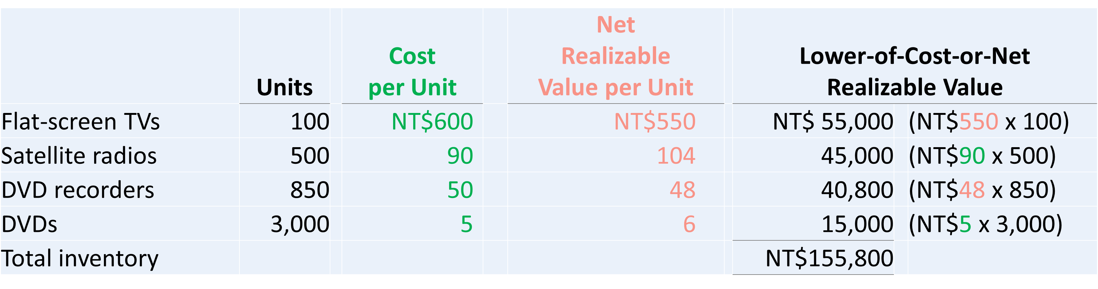
Lower-of-Cost-or-Net Realizable Value (LCNRV)
Review: ACT2111 Chapter 6 P34
Conservatism Principle
Conservatism principle requires company accounts to be prepared with caution and high degrees of verification. Under that, we should use the method which is least likely to overstate the asset and net income
Lower-of-Cost-or-Net Realizable Value (LCNRV)
Choose the lower one between the historical cost and net realizable value as the unit cost of the inventory

Slide 8
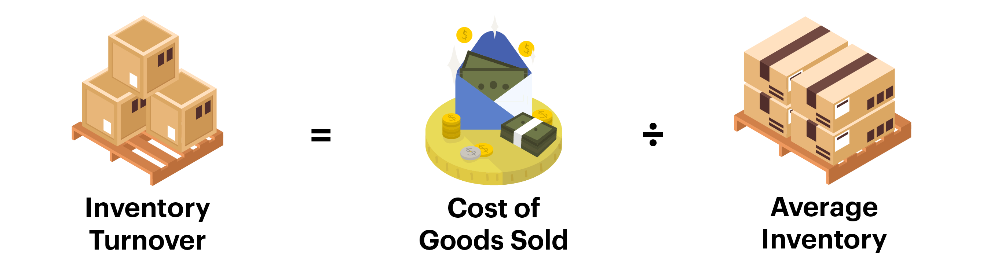
Inventory Analysis
Inventory Turnover = COGS / Average Inventory
Measures the number of times on average the inventory is sold during the period
Average Inventory = (Beg. Inventory + End. Inventory) / 2
Days in Inventory = Days in Year (365) / Inventory Turnover
Measures the average number of days inventory is held.

Slide 9
Difficulties in Tutorial – Chapter 6
Exercise 6-06
Exercise 6-09
Exercise 6-13

Slide 10
Exercise 6-06
Howsham Interiors reports the following for the month of June. Compute inventory and cost of goods sold using FIFO and average‐cost.
Compute the cost of the ending inventory and the cost of goods sold under (1) FIFO and (2) average‐cost.
Which costing method gives the higher ending inventory? Why?
Which method results in the higher cost of goods sold? Why?
 |  | Units | Unit Cost | Total Cost
June 1 | Inventory | 200 | £5 | £1,000
12 | Purchase | 300 | 6 | 1,800
23 | Purchase | 500 | 7 | 3,500
30 | Inventory | 160

Slide 11
Exercise 6-06
Step 1. Calculate Cost of Goods Available for Sale
= Beg. Inventory + Goods Purchased
Precise (Not change under different methods)
 |  | Units | Unit Cost | Total Cost
June 1 | Inventory | 200 | £5 | £1,000
12 | Purchase | 300 | 6 | 1,800
23 | Purchase | 500 | 7 | 3,500
 |  | 1000 |  | 6300
Step 2. Ending Inventory
Ending Inventory = Unit in Ending Inventory * Cost of Each Unit
Average-Cost Unit Cost = 6300 / 1000 Units = 6.3
7
1120
160
FIFO Unit Cost
FIFO End. Inv
Unit in End. Inventory
6.3
1008
Average-Cost Unit Cost
Average-Cost End. Inv
Step 3. Calculate COGS
COGS = Cost of Goods Available for Sale – Ending Inventory
 | COGAS - End.Inv | COGS
FIFO | 6300 - 1120 | 5180
Average-Cost | 6300 - 1008 | 5292

Slide 12
Exercise 6-09
Banovic Footwear applied FIFO to its inventory and got the following results for its ending inventory. Compute lower‐of‐cost‐or‐net realizable value.
The net realizable value per unit at year‐end was tennis shoes €70, running shoes €71, and basketball shoes €74.
Determine the amount of ending inventory at lower‐of‐cost‐or‐net realizable value.
Tennis shoes | 100 units at a cost per unit of €68
Running shoes | 150 units at a cost per unit of €75
Basketball shoes | 125 units at a cost per unit of €80

Slide 13
Exercise 6-09
Answer
 | Unit | Unit Cost | Unit NRV | Cost | NRV | LCNRV
Tennis shoes | 100 | 68 | 70 | € 6,800 | € 7,000 | € 6,800
Running shoes | 150 | 75 | 71 | 11,250 | 10,650 | 10,650
Basketball shoes | 125 | 80 | 74 | 10,000 | 9,250 | 9,250
Total inventory |  |  |  | € 28,050 | € 26,900 | € 26,700

Slide 14
Exercise 6-13
The cost of goods sold computations for Gouda Company and Edam Company are shown below.
Compute inventory turnover and days in inventory for each company.
 | Gouda Company | Edam Company
Beginning inventory | € 47,000 | € 71,000
Cost of goods purchased | 200,000 | 290,000
Cost of goods available for sale | 247,000 | 361,000
Ending inventory | 58,000 | 69,000
Cost of goods sold | €189,000 | €292,000

Slide 15
Exercise 6-13
 |  | Gouda Company |  | Edam Company
Inventory Turnover |  | €189,000 |  | €292,000
 |  | (€47,000 + €58,000)/2 = 3.60 |  | (€71,000 + €69,000)/2 = 4.17
Days in Inventory |  | 365/3.60 = 101 days |  | 365/4.17 = 88 days

Slide 16
Thanks for your listening !

